Slide 1
Java Workshop 9 – Interfaces and Abstract Classes
This class is hands-on, not just abstract.
Ben Schwarz

Slide 2


Interfaces
We ran into an issue in the inheritance workshop when we wanted to add a name to both Cat and Dog, but not Mammal, their superclass. In this situation, there are 3 options:
Duplicate floating code
Create a MammalPet class that extends Mammal and is extended by Cat and Dog
Make a Pet interface
MammalPet
Cat
Dog
Mammal
Pet
Cat
Dog

Slide 3
But what exactly is an interface?
An interface can be thought of simply as a set of methods.
Two unrelated classes can share an interface (have a shared set of methods)
E.g. A Robot class, Cat class and Fighter Jet class.
Unrelated, but all of them can move and stop, and so have methods move and stop.
If these methods all take the same parameters, and return the same types, those methods form a common interface.

Slide 4
Java is a static language
Interfaces are only required to be explicitly defined in static languages, such as java.
Have to define a move and stop interface.
Then define how cat, fighter jet and robot all implement this.
Dynamic languages are more convenient – don’t check till runtime (But if you forgot to properly implement the interface…)

Slide 5
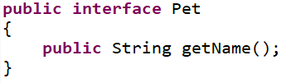
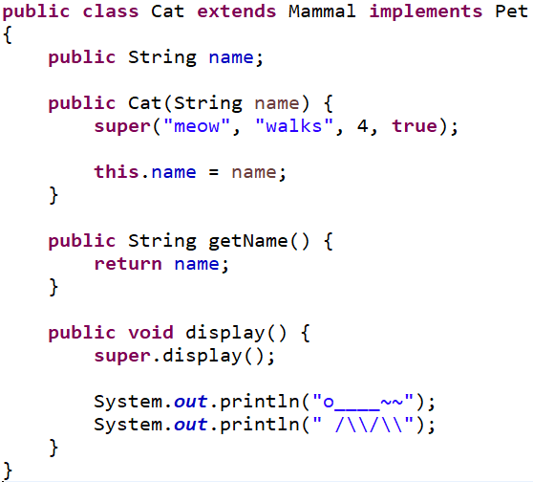
Interface Uses
Interfaces have a few purposes:
Labelling a class with a pre-existing superclass as having specific functionality
Forcing the class to implement said functionality
Adding functionality to a group of existing classes with different hierarchies
Note that a class can implement multiple interfaces.

Slide 6

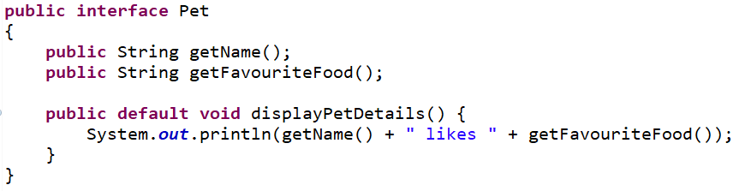
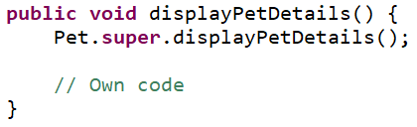
Adding Functionality
Using the default keyword allows an interface to add functionality without relying on the method being defined by an implementing class.
Accessing default methods:
Calling
Super calls

Slide 7
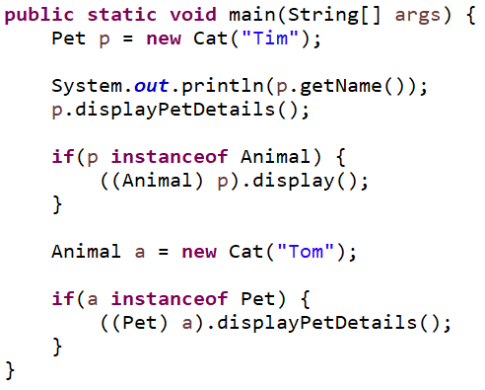
Polymorphism with Interfaces
Variables can have an interface as a type. This means that:
Interface methods are accessible
Class functionality requires casting
The opposite is also true, when an Animal variable holds a Cat for example:
Animal methods are accessible
Interfaces implemented by Cat or Mammal require casting to either the class or interface

Slide 8
Your Turn
Create and implement an interface ‘Reproduceable’ with methods
getChildren [parameters: N/A, return type: ArrayList<Animal>]
addChild [parameters: Animal, return type: void]
displayChildren [parameters: N/A, return type: void]
The interface should be implemented by Cat and Dog.
Since even in our limited hierarchy of animals cats can’t have non-cats as children, you’ll need to prevent such a child from being added.
When displaying children, just list their names.

Slide 9

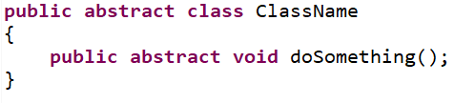
Abstract Classes
Abstract classes are a level closer to implementation than interfaces.
Properties:
Are extended rather than implemented
Can hold attributes
Can have constructors
Can implement methods
Use the abstract keyword to denote methods that must be implemented

Slide 10
Class Details
For the rest of the exercises, the following classes will be used:
Class: Point
Constructors Point(double x, double y)
Attributes double x, y
Methods getDistance(Point p) takes another Point and returns the distance to that point
Abstract Class: Shape
Constructors Shape(Point… vertices)
Attributes Point[] vertices;
Methods getPerimeter() Abstract Methods getArea()

Slide 11
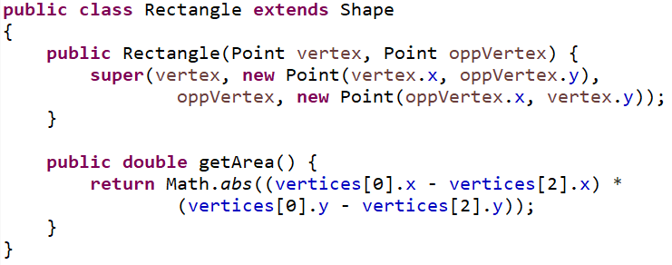
Extending an Abstract Class
Suppose we want to extend a Shape to implement a Rectangle. We have 2 main goals:
Provide a user with all the functionality expected of a rectangle
Avoid duplication of data
Class: Rectangle Extends Shape
Constructors Rectangle(Point vertex, Point oppVertex)
Attributes N/A
Methods Implements Shape.getArea

Slide 12
Your Turn
Add a constructor to Rectangle which takes
A Point as the upper left corner
Doubles for the width and height
Write a SkewRectangle class that
Extends Shape
Creates a rectangle object that isn’t necessarily aligned with the axes
Challenge: Write a Triangle class
The main difficulty here is calculating the area. Use either the trigonometric functions or the perpendicular distance formula
We’re using screen coordinates, so the axes are
Perpendicular distance:
x
y
ax + by + c = 0
(x₁, y₁)
d = |ax₁ + by₁ + c| / √(a² + b²)

Slide 13
Summary
You should now be able to:
Recognise the differences between interfaces and abstract classes
Determine which is more appropriate in a given scenario
Implement abstract methods from an interface or abstract class

